Slide 1
EXE Week 4

Slide 2
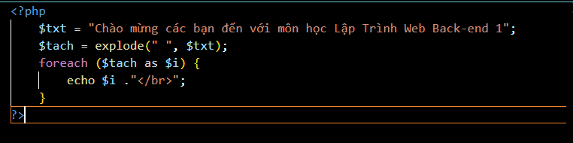
EXE1 code

Slide 3
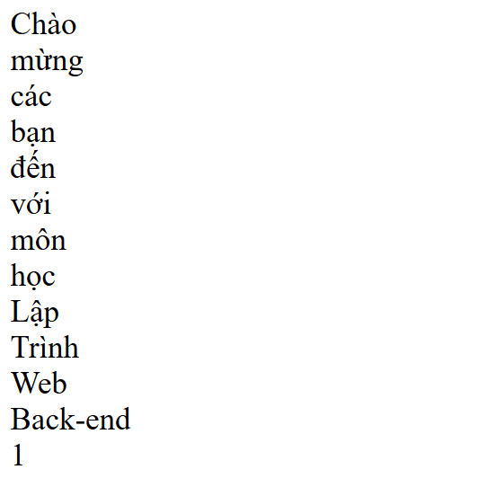
EXE1 result

Slide 4
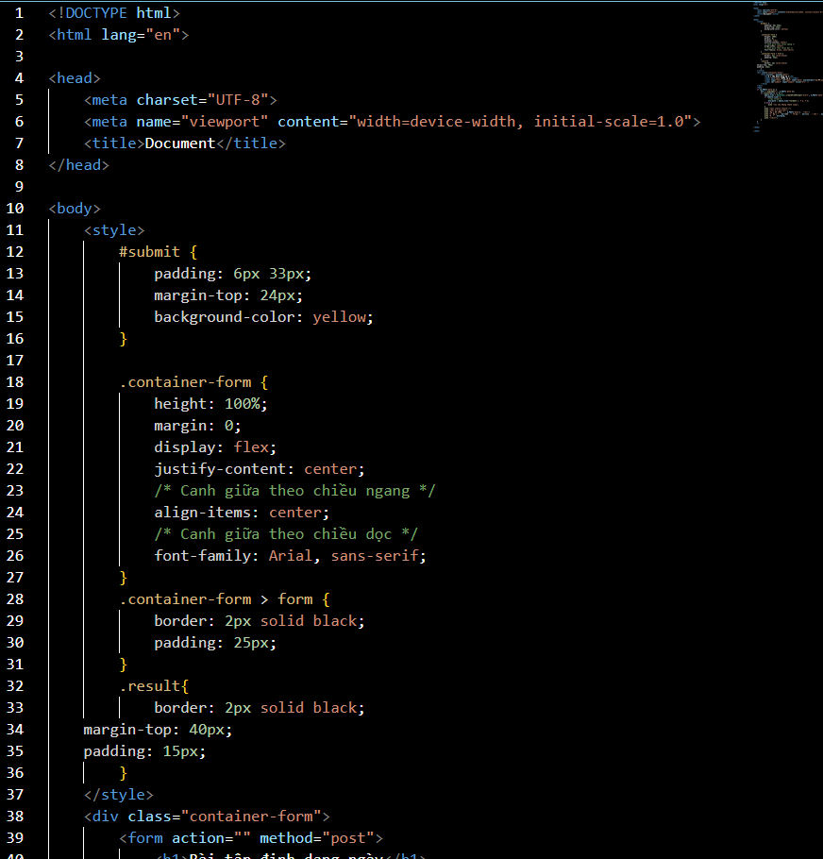
EXE2 code

Slide 5
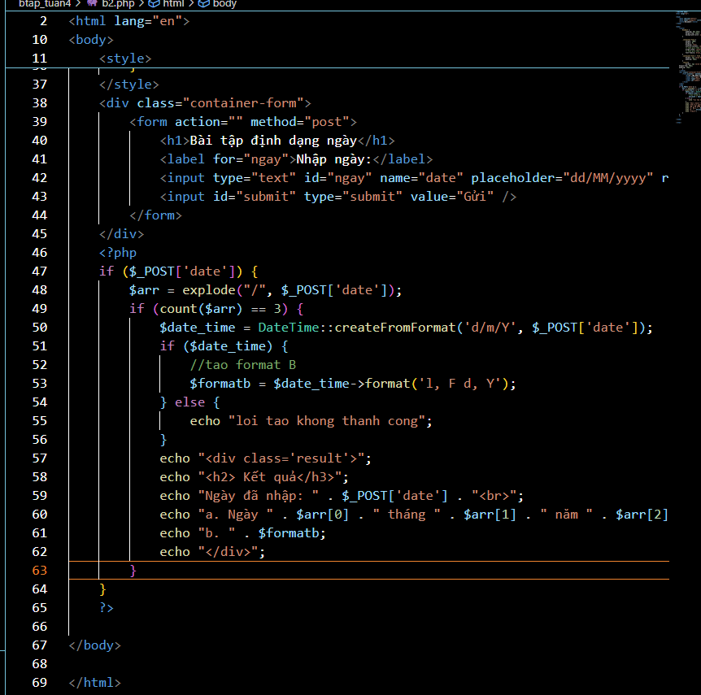
EXE2 code

Slide 6
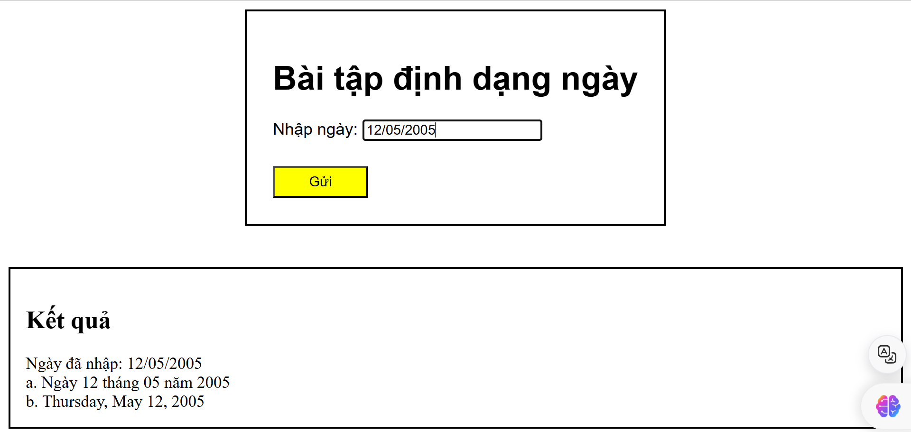
EXE2 result
Screenshot of bai2.php result running on browser

Slide 7
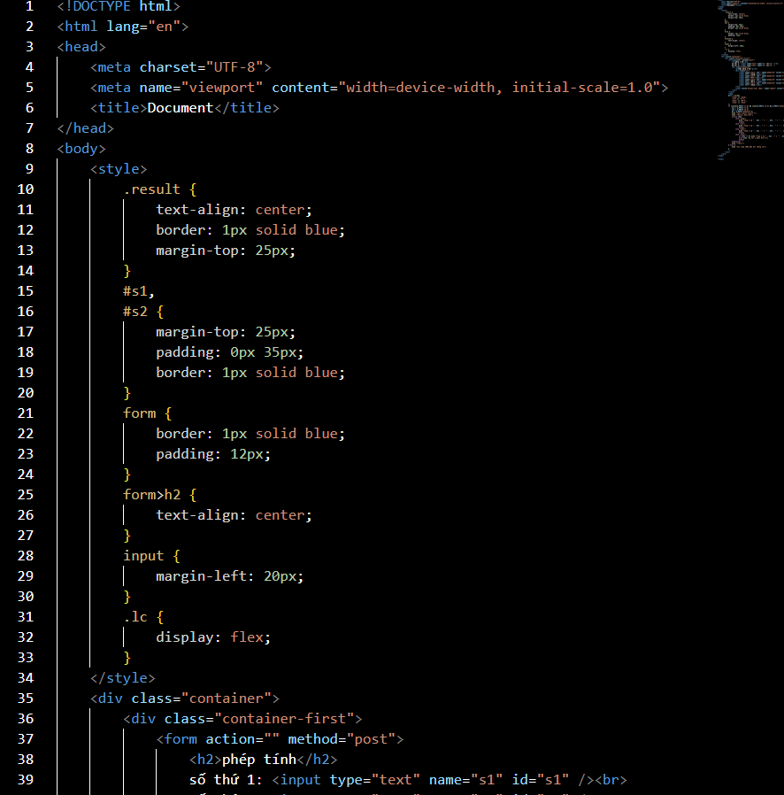
EXE3 code

Slide 8
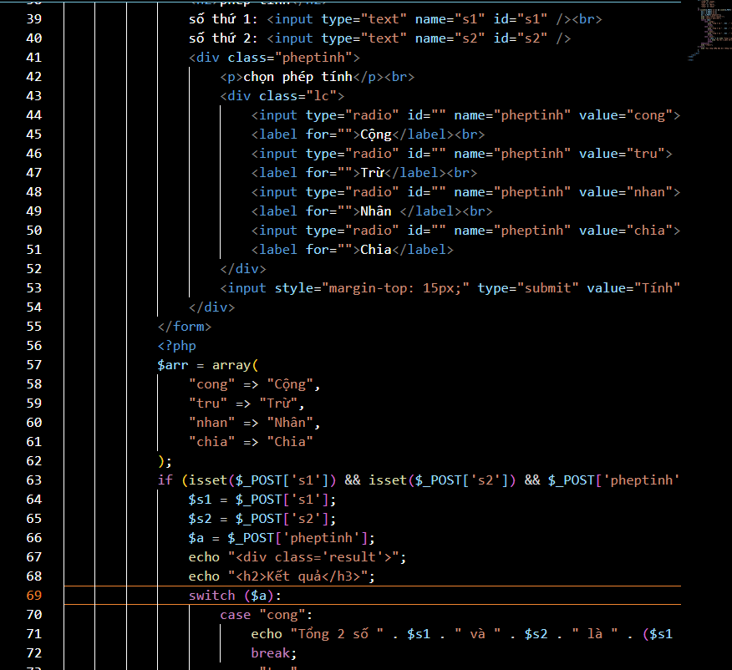
EXE3 code

Slide 9
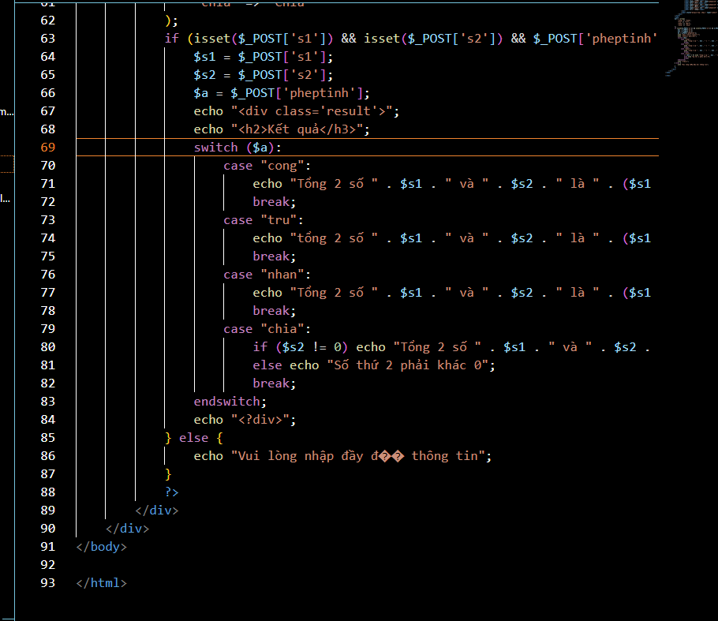
EXE3 code

Slide 10
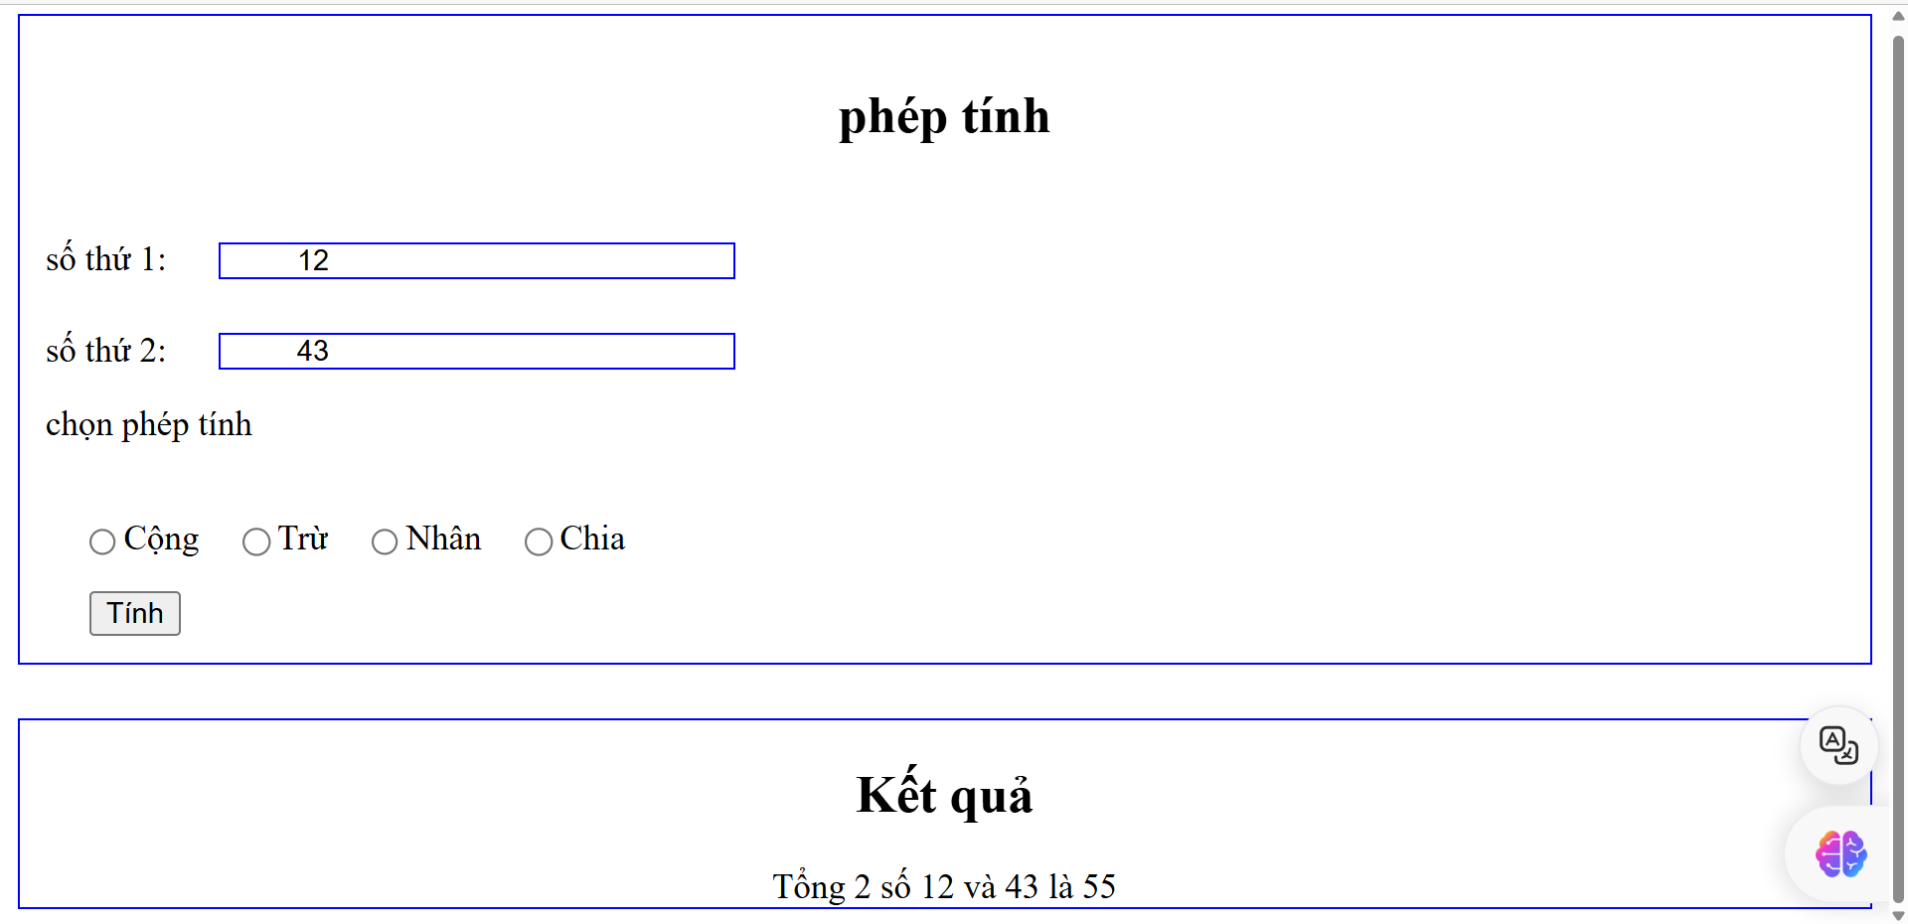
EXE3 result

Slide 11
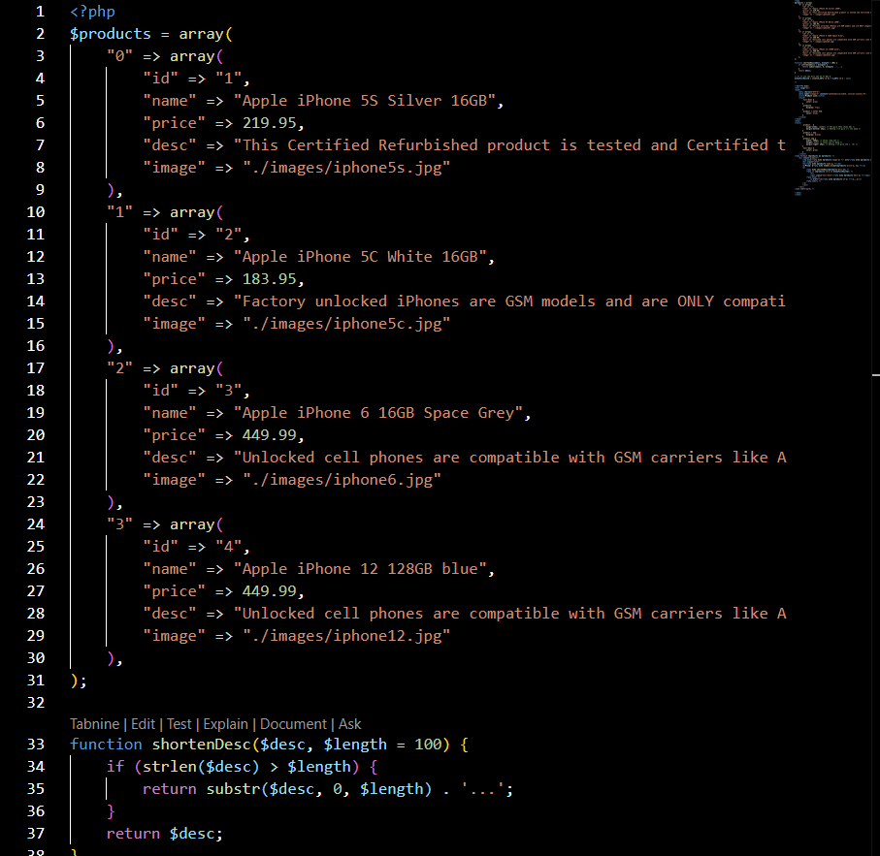
EXE4 code

Slide 12
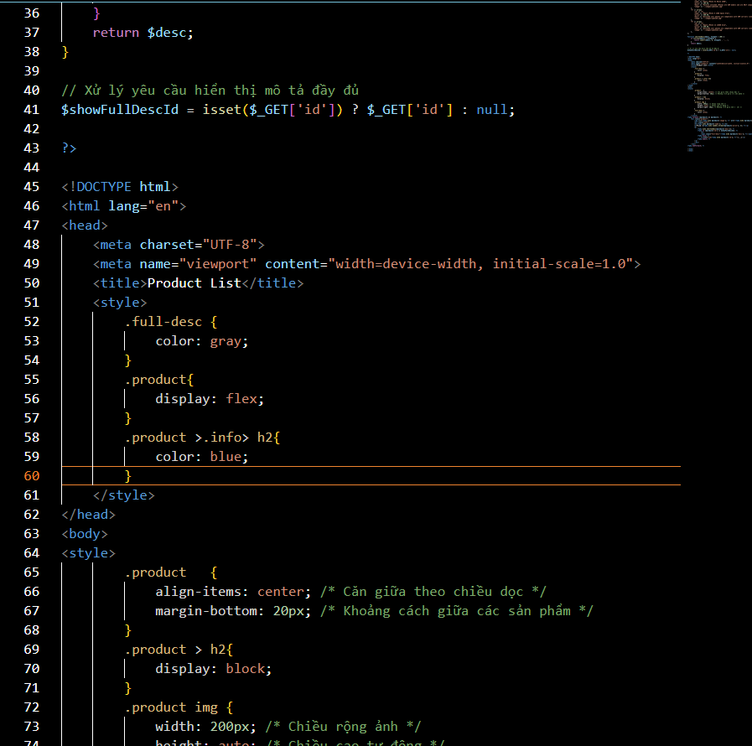
EXE4 code

Slide 13
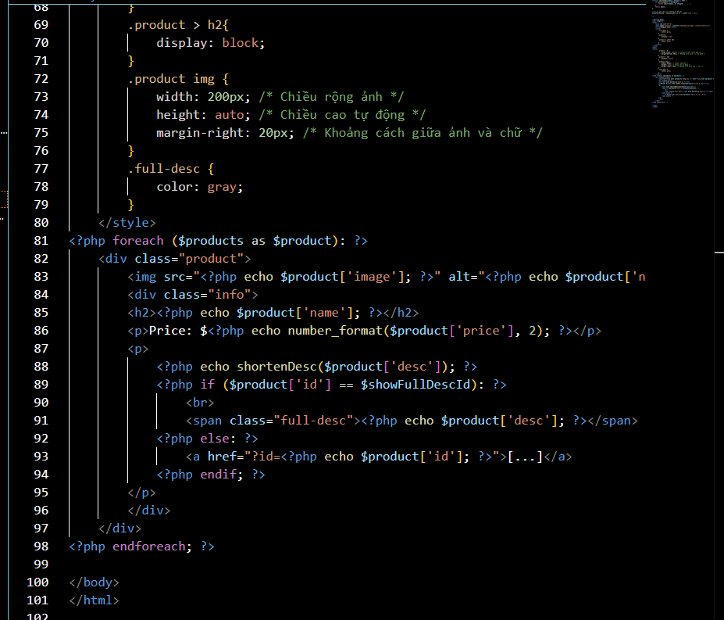
EXE4 code

Slide 14
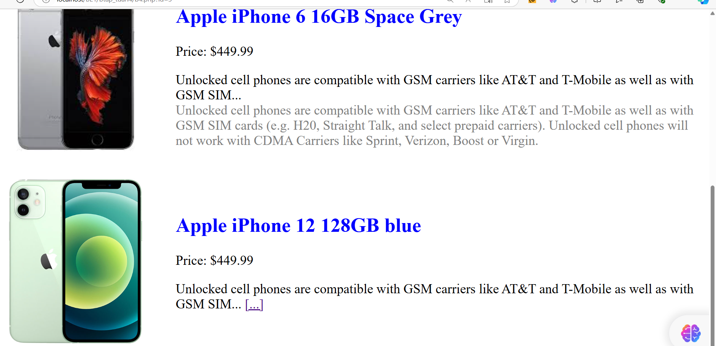
EXE4 result

